Slide 1
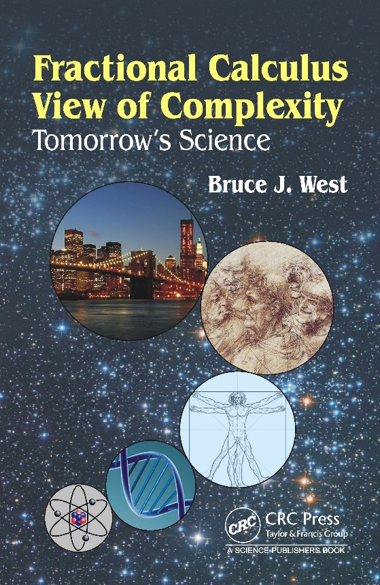
Complexity Science and Fractional Calculus
presented at
Future Applications of
Fractional Calculus
October 17, 2016
Bruce J. West
ST/Senior Scientist Mathematics
Information Science Directorate
Research Laboratory - Army Research Office (ARL-ARO)
bruce.j.west.civ@mail.mil
919-549-4257
Notes:
Ever since I started writing my last book, I have been thinking about how the fractional calculus can be of use in the various scientific disciplines. From the title it should be clear what conclusion I finally came up with from all this thinking. If it is not I will spell it out. The vast majority of the scientific problems that can be solved by making the assumptions that space is homogeneous and local, time is isotropic and without memory, linear dynamics is good first approximation to a system’s behavior, and so on have all been solved. Those that violate one or more of these assumption, do so because of some complexity in the system and the fractional calculus is a vibrant strategy for overcoming such scientific barriers.
This workshop is an attempt to formulate a research vision that transcends the disciplinary structure of science by addressing the applications of the fractional calculus to the resolution of research barriers that have their origin in complexity. In this all too brief introduction I believe you will find that the problems of interest to the Army have this transcendent character.

Slide 2
Outline of Talk
What will we talk about?
  Research thrusts of Mathematics Division, Army Research Office (ARO)
    How does complexity enter the picture?
    What does that imply for fractional calculus?
  Research campaigns in US Army Research Laboratory (ARL)
  Potential applications of fractional calculus in ARL research campaigns
Notes:
I will start things off by outlining some of the things in mathematics that the Army Research Office is interested in supporting and hopefully you will see how that relates to your own research interests.
I will give a rapid overview of the research support philosophy of ARO and more specifically of the Mathematics Division. My hope is to convey a sense of the far reaching research vision, rather than focusing on any particular program. Also to bring out how complexity is always in the background entailing the use of the fractional calculus.
The camera will then pan out to capture the research vision of the Army Research Laboratory, of which ARO is a part. Then to argue how the fractional calculus may contribute to each of these research campaign areas.

Slide 3
ARL/ARO Investment Strategy
Opportunity Driven vs. Need Driven Research
Goal is a Balance Between Near-
and Long-Term Investments
Need Driven Research: improve specific capabilities or overcome identified technology barriers
(evolutionary: ripples)
Opportunity Driven Research: develop and exploit scientific breakthroughs to produce revolutionary new capabilities
(revolutionary: tsunami)
Opportunity
Driven
Return
(Understanding
& Performance)
Needs Driven
Investment ($, Time)
And
Selective Investing: Investing where we can make a difference
Coordinated and complementary; not duplicative
Potential to advance the discipline, and ultimately the Army
Notes:
The research investment strategy of ARL/ARO has as its goal the balance between short-term and long-term research interests. In the short term research is driven by technological challenges, or the incremental advancement of science. In the figure this is symbolized by da Vinci’s design of a giant bow, intended to breach a castle wall. Note the man in the foreground to give a measure of scale. This is an evolutionary improvement on already existing technology and ripples outward to modify the landscape.
In the long-term we have opportunity driven research, here symbolized by da Vinci’s design of a helicopter; rendered a full four hundred years before the rest of science could catchup. Here ARO invests in scientific breakthroughs to produce revolutionary new capabilities; transforming the ripple into a tsunami.
This is the hope for the present workshop. If a single revolutionary idea emerges from the presentations and discussions, we will have beaten the odds.

Slide 4
Army Research Office
ARO Mathematics Division
Probability and Statistics (Dr. Andrew Vlasic SETA Contractor)
  Tales of tails
  Non-commutative probabilities
Modeling of Complex Systems (Dr. Joseph Myers)
  Social and sociolinguistic modeling
  Geometric and topological modeling
Computational Mathematics (Dr. Joseph Myers)
  Multi-scale methods
  Fractional PDE methods
Biomathematics (Dr. Virginia Pasour)
  Fundamental laws of biology
  Inverse problems
Notes:
The mathematics division of ARO consists of four project areas that in one way or another recognize the importance of complexity, as the motivator for the development of new mathematical tools.
Probability and statistics seeks to understand the scientific implications of inverse power law distributions and the importance of the order in which operations are performed in uncertain environments. Even the computational mathematics program the complexity of turbulence motivated an investment into the numerical solutions of fractional partial differential equations.
I do not present these programs here to review them in any way, but to provide you with a glimpse of where your view of the applications of the fractional calculus might find a receptive ear. For example, how might the non-Newtonian materials in the biomathematics program give rise to new theories of wound healing, traumatic brain injury, or even to new laws of biology.

Slide 5
Of what use is fractional calculus?
Fractional calculus can help physical, life and social scientists to understand problems that are otherwise too;
  Big (the bio- and social-spheres)
  Small (molecular structure, individuals)
  Slow (macroevolution of species, societies..)
  Fast (photosynthesis, phase transitions)
  Remote in time (early extinctions, genetics, memory)
  Remote in space (life at extremes, heterogeneity)
  Complex (human brain, IoBT)
  Dangerous or unethical (infectious agents, cyber fog)
Notes:
Fractional calculus can help the scientific disciplines formulate and solve problems that violate the underlying assumptions of their traditional models. Phenomena that are too big, too small, depend on behavior that is remote in space or time, that is explicitly too complex or too dangerous.

Slide 6
Modeling of Complex Systems
Complexity-induced barriers to understanding
  Heterogeneity in space
  Non-locality in time
  No characteristic time scales (fractals, scaling)
    Geometrical, statistical, dynamical
  Dynamics
    Strange attractors
    Non-integrable Hamiltonians
    Fractional differential equations
  Trajectories are chaotic
    Ensembles of chaotic trajectories
    Scaling ensemble probability distribution functions
    Fractional probability calculus
  How do we begin to build a coherent picture?
Notes:
The various ways complexity is manifest as a research barrier are indicated. Much of this was anticipated by the late Benoit Mandelbrot in his generalization of Brownian motion to fractional Brownian motion, where he used the fractional calculus to incorporate memory into statistical time series.
The scale-free aspect of fractal processes makes them unsuitable to be represented by analytic function. Such non-analytic functions have diverging integer-order derivatives, but have finite fractional derivatives. Consequently, the fractional differential equations are the natural representation for the equations of evolution of fractal phenomena that evolve over time.
However, even nonlinear dynamic systems that have chaotic trajectories, have ensemble distribution functions that satisfy fractional kinetic equations. Leading to a fractional probability calculus.
How do we make a coherent picture out of all of this?

Slide 7
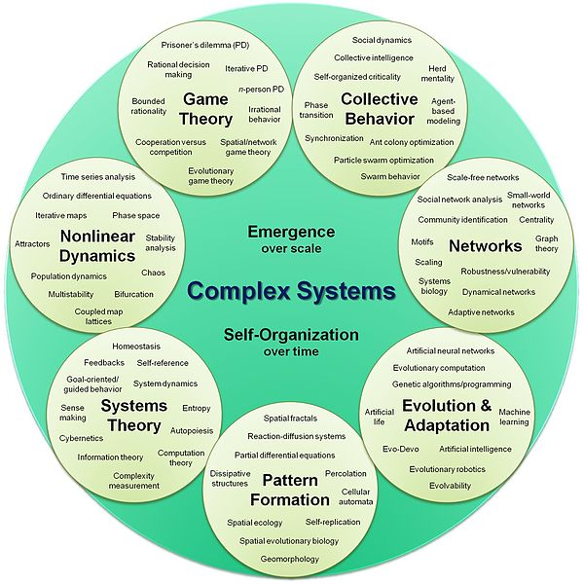
Complex Systems
Can these be synthesized?
Is the fractional calculus entailed by complexity?
Notes:
Lest you be lulled into a false sense of security, let me present some additional mathematical models that have unique complexity properties. The complexity of chaos in nonlinear dynamical systems, with its sensitive dependence on initial conditions, is very different from the feedback behavior of homeostasis in systems theory, which shares some characteristics with collective intelligence of networks, that is unlike reactive-diffusive systems.
The short answer to the question is no. But let us take a step back to Newton and his version of the differential calculus, fluxions. No where in the Principia is there any mention of fluxions, all the argument are geometrical. Unless one looks very closely and behind those arguments are the differential we know. Thus, the differential calculus is not entailed by classical mechanics, but it is certainly a more natural description than geometry.
In the same way the fractional calculus is not entailed by complexity, but is certainly the more natural way to describe the behavior of complex phenomena.

Slide 8
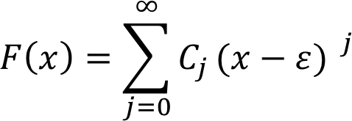
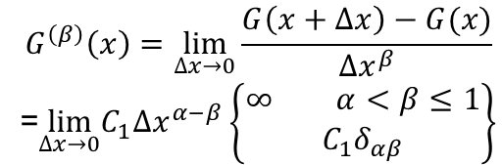
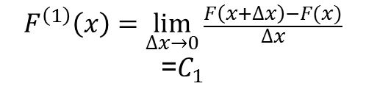
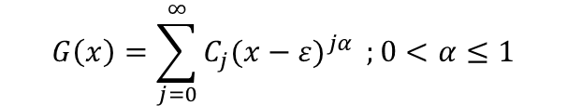
Complex Phenomena
MATHEMATICAL MODELING
Analytic functions: Taylor series non-analytic functions: gen. Taylor series
Ordinary calculus
Newton’s Laws Fractional calculus
new laws
$$G\left(x\right)=\sum_{j=0}^{∞}{C_{j}{(x−ε)}^{jα}} ;0<α≤1$$
$$G^{\left(β\right)}\left(x\right)=\lim_{∆x→0}{\frac{G\left(x+∆x\right)−G(x)}{∆x^{β}}}$$
=$\lim_{∆x→0}C_{1}{∆x}^{α−β}\left\{\begin{matrix}∞\begin{matrix} & α<β≤1\end{matrix} \\ C_{1}δ_{αβ}\end{matrix}\right\}$
$$F^{\left(1\right)}\left(x\right)=\lim_{∆x→0}{\frac{F\left(x+∆x\right)−F(x)}{∆x}}$$
=$C_{1}$
Bessel
Hermite
Jacobi
Legendre
,
,
Jacobi
poly-fractonomial
Zayernouri & Karniadakis
J. Comp. Phys. 252 (2013).
Notes:
The 19th century was an era in which analysis blossomed, giving rise to spate of specialized functions associated with such names as Hermite, Bessel, Legendre, Laguerre, Weierstrass and on and on. Most were associated with the solution to eigenvalue problems.
We are now be entering into a similar era for the fractional calculus, with solutions to the fractional Sturm-Liouville eigenvalue problem, with deference being given to the 19th century forerunners, with such names as the Jacobi poly-fractonomials; and the tempered Jacobi poly-fractonomials.
This is truly an exciting time to witness the development of these new mathematical concepts and to help identify the complex phenomena they describe.

Slide 9
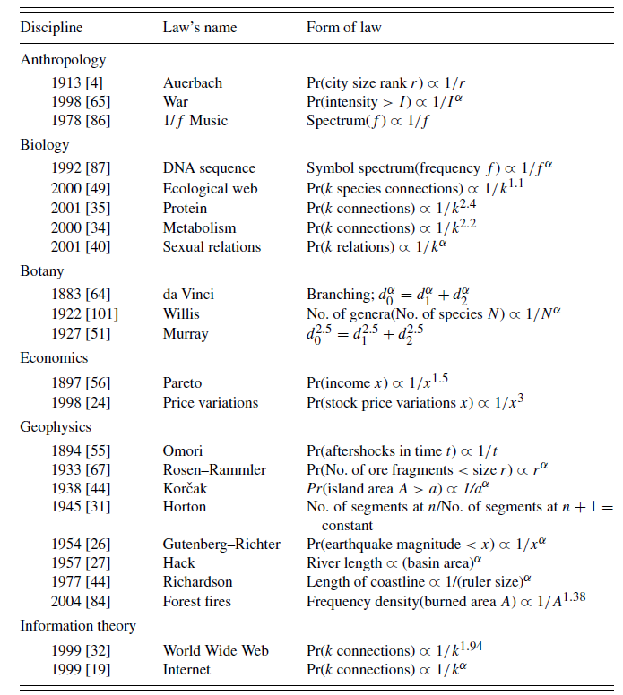
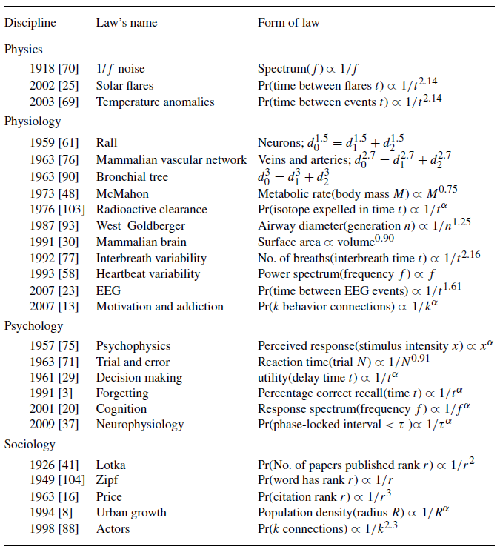
Empirical Power Laws
Complex Webs: Anticipating the Improbable, B.J. West and P. Grigolini, Cambridge (2011).
Notes:
Here is a list of phenomena covering 10 disciplines, whose regularity is captured by scaling laws and/or power law distributions. Such behavior has been the hallmark of complexity for many scientists and here I take it to be the harbinger of the fractional calculus. From the inverse power law tail of income first discovered by Pareto and now bears his name, to the distribution of airway diameters in the bronchial tree, to the rank ordering in the number of citations of published papers. The complexity of the underlying phenomena in each of these cases I maintain will lend itself to a fractional calculus description sooner or later.

Slide 10
Army Research Laboratory
ARL Research Campaigns
Human Sciences
Information Sciences
Computational Sciences
Science-for-Maneuver
Materials Research
Science for Lethality and Protection
Assessment and Analysis
Each campaign has complexity-induced research barriers
Notes:
Here is the list of the ARL research campaigns, that cut across the ARL Directorates, intended to highlight the science being addressed and not the applications being made. I maintain that each of these campaign areas has a complexity-induced research barrier. Moreover, each of these barriers can be overcome using a strategy that involves the fractional calculus. I will present exemplars in each of the campaigns.

Slide 11

Human Sciences Campaign
Human Sciences is focused on gaining a greater understanding of individual physical, perceptual, and cognitive performance through Human-Physical Interface, Human-Human Interface, and Human-Technology Interface.
The application of the fractional calculus appears at the nexus of physics and physiology in the measurement of healthy tissue and tumors. For example, Magin et al., J. Mag. Res. 190, 255 (2008) generalize the Bloch-Torrey equations used in modeling nuclear magnetic resonance (NMR) and magnetic resonance imaging (MRI):
The influence of a complex social network on the behavior of an individual within the network was determined, using renormalization group arguments, to be the fractional rate equation, with a Mittag-Leffler function solution:
$$τ^{α−1}∂_{t}^{α}\left[M_{±}\left(r,t\right)\right]=γ\left(r,t\right)M_{±}\left(r,t\right)+K_{β}∇^{2β}\left[M_{±}\left(r,t\right)\right]$$
$$∂_{t}^{α}\left[P\left(t\right)\right]=−μP\left(t\right)→P\left(t\right)=E_{α}(−μt^{α})$$
Notes:
Human science is a catchall name intended to capture anything having to do with a human being. The next generation of tools needed to determine a person’s state of well being will require generalizations of biophysics equations to capture the non-Newtonian nature of bio- fluids and materials. The example given here is of Richard Magin’s extension of the Bloch-Torrey equations for nuclear magnetic resonance used for fMRIs. Derivation was based on the CTRW.
A socio-psychological application is to modeling the shift in individual behavior from one-on-one to interactions within a group. There are many network models that focus on the collective behavior of the network, but determining the influence of the group on the individual is rare. Here an individual in isolation is given by dashed curve, this is the probability that person will change her mind. The colored curves are a calculation of ten thousand interacting individual influencing the person of interest, in the subcritical, critical and supercritical domain. The dynamics of the group are projected down to a single fractional rate equation shown, and the Mittag-Leffler solution is seen to fit the numerical data in all three regions.
The scalar fractional rate equation captures the influence of ten thousand nonlinear equations on the behavior of the individual, this suggests an area of application of the FC that has yet to be explored.

Slide 12

Information Sciences Campaign
Information sciences is focused on gaining a greater understanding of emerging technology opportunities that support intelligent information systems that perform acquisition, analysis, reasoning, decision-making, collaborative communication, and assurance of information and knowledge through Sensing and Effecting, System Intelligence and Intelligent Systems, Human and Information Interaction, Networks and Communications, and Cyber Security.
A direct generalization of the Poisson distribution for the arrival time of information packets was made by Laskin, Comm. Non. Sci. & Num. Sim. 8, 201 (2003) to a fractional Poisson process (FPP) expressed in terms of derivatives of the Mittag-Leffler function:
$$P\left(N,t\right)=\frac{{\left(−z\right)}^{N}}{N!}E_{α}^{\left(N\right)}(z)\begin{matrix}, & at & z=−{(γt)}^{α}\end{matrix}$$
At early times the messages look nearly Poisson.
At late times the messages have IPL statistics, whose time series occurs in bursts.
Notes:
Information sciences is another of these collective terms. One development that caught my eye was the generalization of the Poisson distribution to a fractional Poisson process developed by Laskin. The analytic form for the probability distribution function is in terms of the derivative of the Mittag-Leffler function. At early times the distribution looks nearly Poisson, but at late times the distribution becomes inverse power law, independently of the number.
A little thought would convince you that a sequence of message at early times would appear to be almost Poisson, however at late times it would appear to have an intermittent or bursty nature. Without the FPP such a time series would be interpreted as two distinct processes. This probably has implications for signal processing that is beyond my ken.

Slide 13
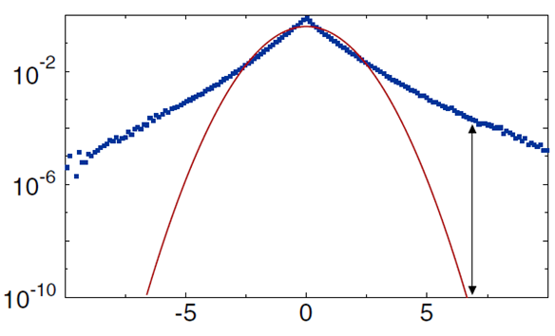

Computational Sciences Campaign
Computational sciences is focused on advancing the fundamentals of Predictive Simulation Sciences, Data Intensive Sciences, Computing Sciences, and emerging Computing Architectures to transform the future of complex Army applications.
The two-scale model of Brownian motion has a fractional stochastic differential representation: Basset, A Treatise on Hydrodynamics, Vol. 2 (1888):
Mainardi and Pironi, Extracta Mathematicae 11, 140 (1996), identified the integral as a fractional derivative of order ½; experiments have experimentally verified the solution in the last few years.
A fundamental barrier to active control of aerodynamic surfaces is turbulence and our failure to understand complex fluid dynamics.
$$\frac{dV(t)}{dt}=−γV\left(t\right)−U^{′}\left(Q\right)−∁\int_{0}^{t}{\frac{dτ}{\sqrt{t−τ}}}\frac{dV\left(τ\right)}{dτ}+f(t)$$
Levy
Gauss
Wind speed change
$$E\left(k\right)∝k^{−\frac{9−2β}{3}} ; Kolmogorov−Levy scaling$$
Normalized standard deviation
Notes:
Computational sciences is often viewed as an incremental science, improving on existing algorithms in an evolutionary way. Fractional calculus can be seen to have an impact here as well. For example, in the century old problem of classical diffusion, it is seen that 25 years before Einstein solved the diffusion equation, Basset showed that the dynamic equation was a fractional equation of motion, what we now call a fractional Langevin equation. The solution at short times is very different from classical diffusion and has been verified experimentally.
The fractional dynamic equations, such as those for fractional Brownian motion, are replaced by fractional kinetic or phase space equations for the probability density, as in the case of homogeneous turbulence. The fully fractional kinetic equation has an exact solution of the scaling form indicated. When alpha=1 and beta is less than two it gives levy statistics for homogeneous turbulence. It also replaces energy Kolmogorov scaling with Kolmogorov-Levy scaling.
Here again the domain of turbulence, one of the mysteries of fluid mechanics, is wide open to application, as a number of people in this audience are well aware.

Slide 14

Science-for-Maneuver Campaign
Sciences-for-Maneuver is focused on gaining a greater fundamental understanding of advanced mobility systems and their supporting architectures -- critical to the future Army's movement, sustainment, and maneuverability through Energy and Propulsion, Platform Mechanics, Platform Intelligence, and Logistics and Sustainability.
One interface between the complexity of the future battle space and science involves the physical restrictions on the maneuverability of unmanned aerial vehicles (UAV).
The science limitations are two-fold: the lack of mathematical tools and our restricted understanding of low Reynolds number aerodynamics.
One of the principles that guides the design of micro-UAVs are allometry relations, between a system's functionality and size, for example, between the wing size and body mass of flying animals.
The ubiquity of allometry relations has been
explained by West & West, Frac. Calc. & App.
Anal.15 (2012) in terms of the scaling PDF quoted
In the Computational Science Campaign:
$$\left\langle Y\right\rangle =a{\left\langle M\right\rangle }^{b}$$
Notes:
Sciences-for-Maneuver is another catchy title for all the things we do not understand about mobility, including getting stuck in the mud.
An example of the use of the fractional calculus is in the design of UAVs where in nature’s world the wing span and total body weight of birds satisfy an allometry relation. We have found that such universal allometry relation are a consequence of the scaling of the underlying PDF.

Slide 15
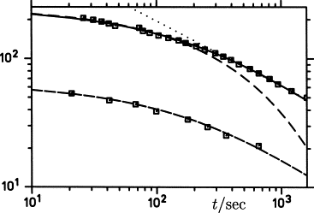
Materials Research Campaign
Materials Research is focused on fundamental research for scientific discovery and innovative problem-solving to provide superior materials and devices needed to achieve lasting strategic land power dominance through Structural Materials, Electronics, Photonics, Energy and Power, Biotechnology and Bioinspired, High Strain and Ballistic Materials, and Manufacturing Science, Processing and Sustainment.
The relaxation of disturbances in complex materials such as taffy, tar, or polymers, are not described by simple rate equations and have been shown to require a fractional relaxation equation to describe their dynamics. The solution to such equations are given by the Mittag-Leffler function by Glöckle & Nonnenmacher, J. Stat. Phys. 71 (1993).
Nutting
Mittag-Leffler function (MLF)
Kohlrausch-Williams-Watts
Notes:
Materials research is concerned with the next generation of materials and their design. The understanding of viscoelastic materials that has benefitted greatly from the fractional calculus. The properties of other non-Newtonian materials, such as response characteristics of cartilage to trauma could benefit from fractional modeling.

Slide 16

Sciences for Lethality & Protection Campaign
Sciences-for-Lethality and Protection is focused on gaining a greater understanding of emerging technologies that support weapon systems, protection systems, and the mechanisms of injury affecting the warfigther through Lethality Research for Soldiers and Army Platforms, Protection Research for Soldiers and Army Platforms, and Battlefield Injury Mechanisms.
The research into disruptive energetics is focused on the exploration of formulations of energetic materials, which seeks to understand very high energy density storage and release on desired time scales. For anomalous diffusion the fractional reaction-diffusion equation is more appropriate
See, for example, del-Castillo-Negrete, Carreras & Lynch, PRL 91 (2003); Baeumer, Kovacs & Meerschaert, Comp. & Math. with Appl. 55 (2008).
Viscoelastic properties of soft biological tissues provide information useful in medical diagnosis and the treatment of wounds. Meral, Royston & Magin, Comm. Nonl. Sci. Nu. Sim. 15 (2010), explain that non-invasive elasticity imaging techniques, reconstruct viscoelastic material properties from dynamic displacement images and the reconstruction algorithms are sensitive to the viscoelastic models chosen.
$$∂_{t}\left[φ\right]=γ∂_{x}^{β}\left[φ\right]+F\left(φ\right)$$
Notes:
Sciences-for-Lethality and Protection is another polyglot.
The fractional reaction-diffusion equation has given rise to new insights into disruptive energetics, that is to understand how things go ‘boom’.
Here again, we see that into which ARL research campigns applications are put is not unique. Under the rubric of protection and battlefield injury mechanisms we can put the treatment of wounds, healing, traumatic brain injury and even post traumatic stress disorder (PTSD). The fractional calculus can model the response of biomaterials to violent disruption, as well as the socio-psychological response to trauma.

Slide 17
Assessment and Analysis Campaign
Assessment and Analysis is focused on supporting evaluators, PMs, and decision makers; modernizing the Army's capabilities in engineering-level analyses of technologies and systems; and leveraging those strengths to create fundamentally new capabilities through Assessment of Science and Technology, Science and Technology of Assessment, Assessing Mission Capability of Material, and Material Capable of Assessing Mission Capability.
Two threads that run through the forecasting theme, whether it is the impact of scientific or technologic discovery, assessing mission capability of systems, or system failure, is the significance of uncertainty and the sensitivity of system dynamics to that uncertainty.
As the process being considered became more complex, the theory of failure, necessarily, became correspondingly more complex. In the Information Science Campaign we introduced the fractional Poisson process (FPP). This should be the backbone of a new theory of failure.
The world is filled with stochastic vibrations; the aircraft response to clear air turbulence, bridge cables to strong winds and the sway of tall buildings to earthquake tremors. In order to determine the probability the structures will survive their response, the reliability of the stochastic fractional dynamic system must be determined.
Notes:
Assessment and analysis develops new tools to determine how well we are doing with the applications of the new science to problems of interest to the Army. How does the prediction of success, or more importantly, the prediction of failure depend on the statistics of uncertainty? The fractional Poisson process immediately comes to mind to replace Poisson statistics as the basis for a new theory of failure.
Note that the first result of such a new theory is that the rate of failure becomes ill defined. Consequently, the nice one-parameter that characterizes a Poisson process is tossed out and we must determine a new metric to guide the manufacture of widgets.

Slide 18
I have talked long enough.
Do you have any questions for me?

